Slide 1
Application: Tin Sulfide Photovoltaics
Device architecture and parameters of interest:
Model:
SCAPS (a Solar Cell Capacitance Simulator), software developed at the University of Gent
https://scaps.elis.ugent.be/
Ag
ITO
ZnO
Zn(O,S)
S_{eff}, ΔE_{c}
SnS
µ, τ
Mo
SiO₂
R. E. Brandt, R. C. Kurchin, et al. Joule 2017, 1(4), 843.

Slide 2
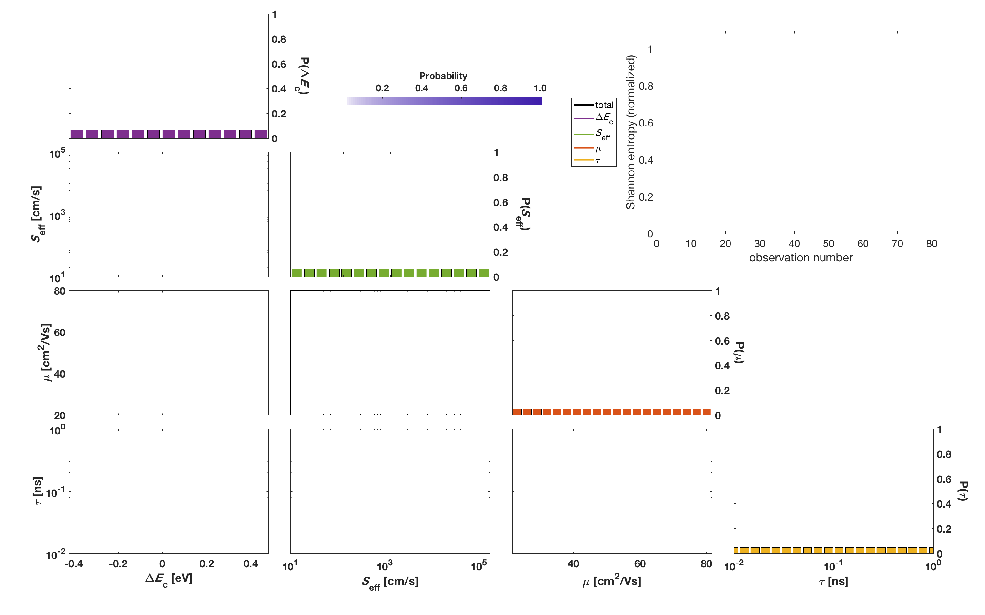
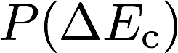
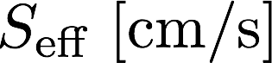
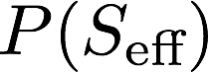
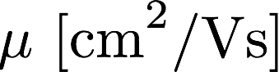
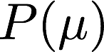
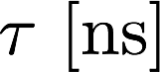
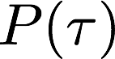
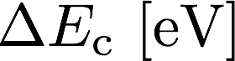
4D probability distributions are gnarly!
Ag
ITO
ZnO
Zn(O,S)
S_{eff}, ΔE_{c}
SnS
µ, τ
Mo
SiO₂
Probability
R. E. Brandt, R. C. Kurchin, et al. Joule 2017, 1(4), 843.

Slide 3
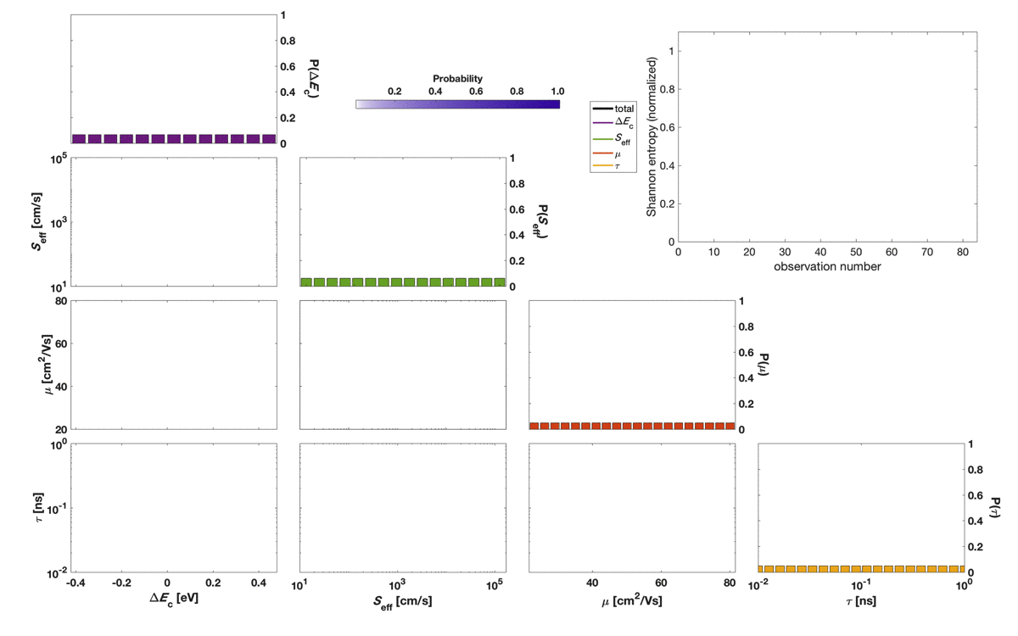
Feed me data!
Probability
R. E. Brandt, R. C. Kurchin, et al. Joule 2017, 1(4), 843.

Slide 4
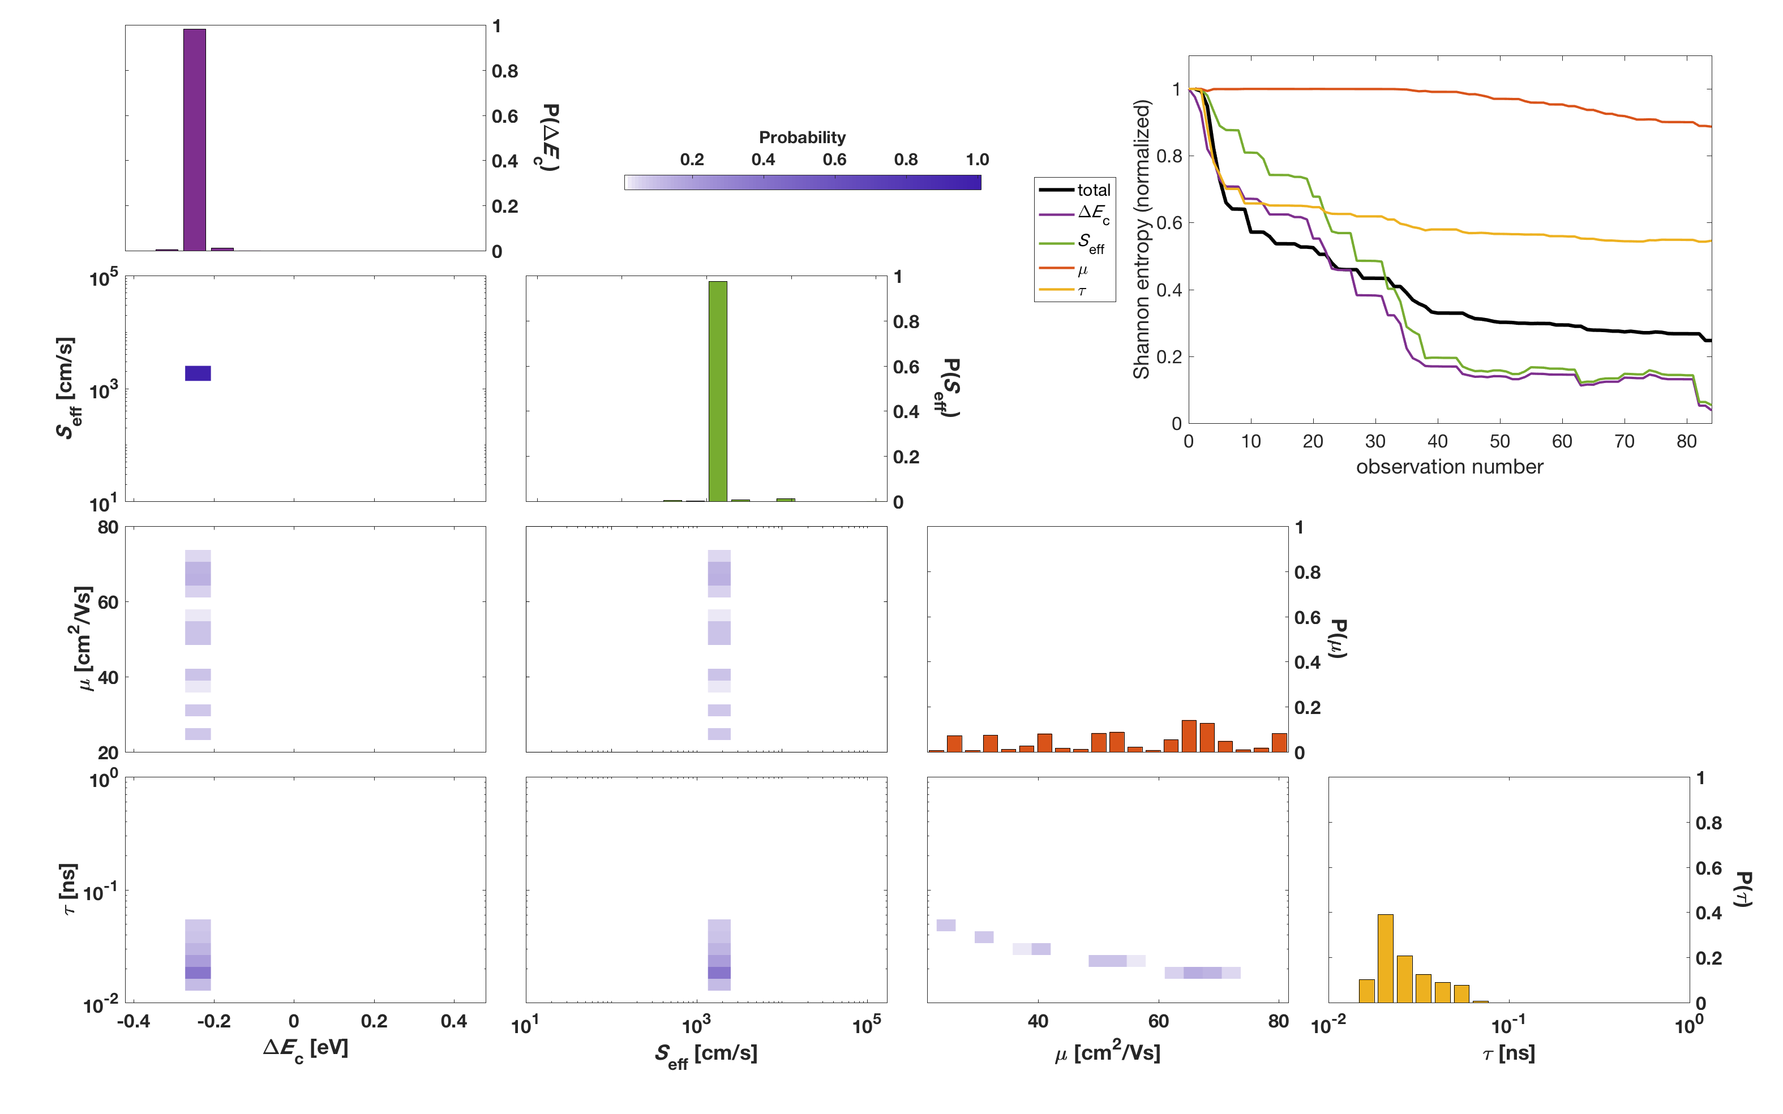
Let’s step through it
??? ???
Probability
R. E. Brandt, R. C. Kurchin, et al. Joule 2017, 1(4), 843.

